Slide 1
CS5551 Advanced Software Engineering 08/23/2018 Tutorial 1

Slide 2
Topics to cover
GitHub
ZenHub
Creately
Web storm, Brackets IDE’s
Android Studio
Ionic Installation
Node/NPM

Slide 3
GitHub

Slide 4
Git Basic Tasks
1. Create Git remote repository using Git account
2. Clone Git repository to your local
3. Use Git to add file to local machine
4. Modify files and use Git to commit changes
5. Use Git to push the commit to remote
6. Use Git to pull (sync) content with remote

Slide 5
Git Project Management Tasks
1. Use Git to branch a project
2. Use Git to check different branches
3. Use Git to merge different versions

Slide 6
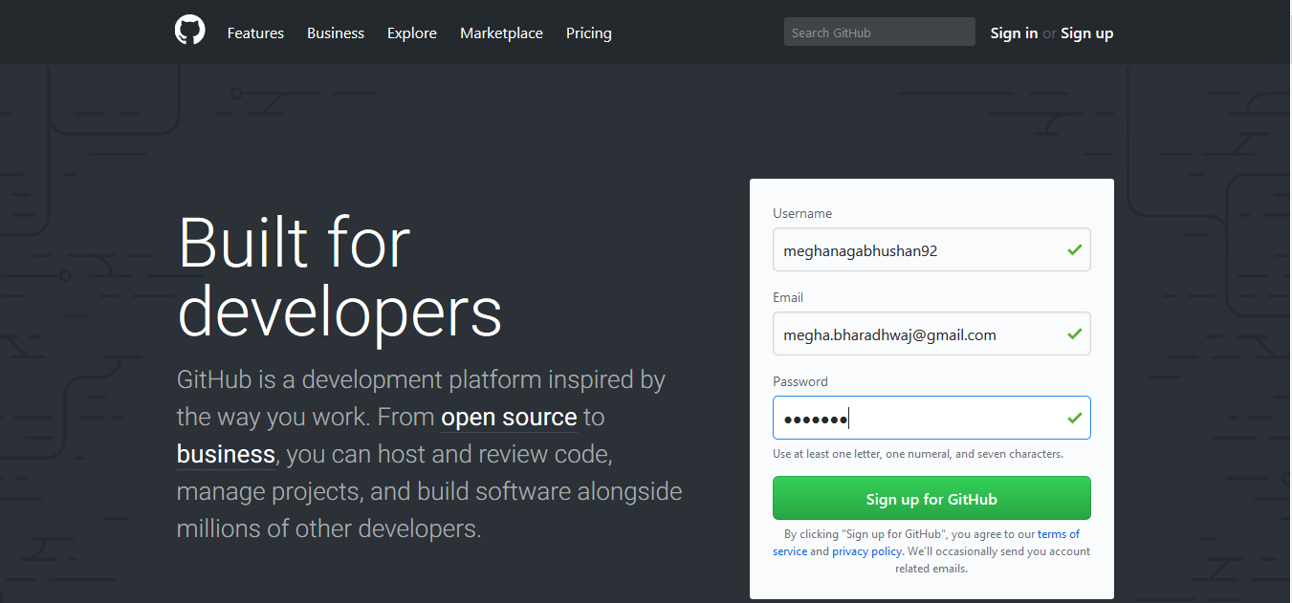
1. Create Git Account
https://github.com/

Slide 7
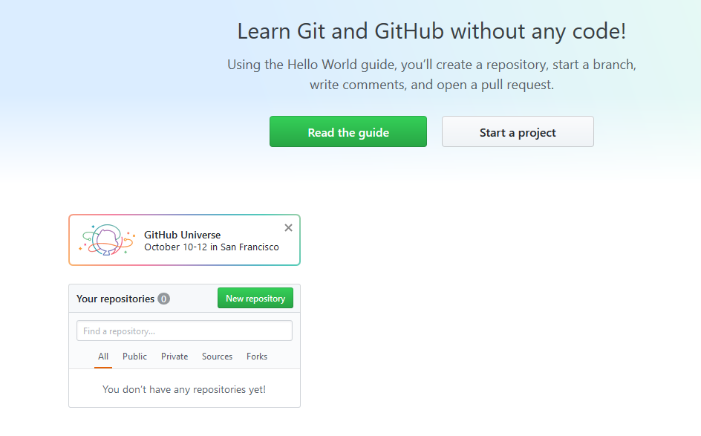
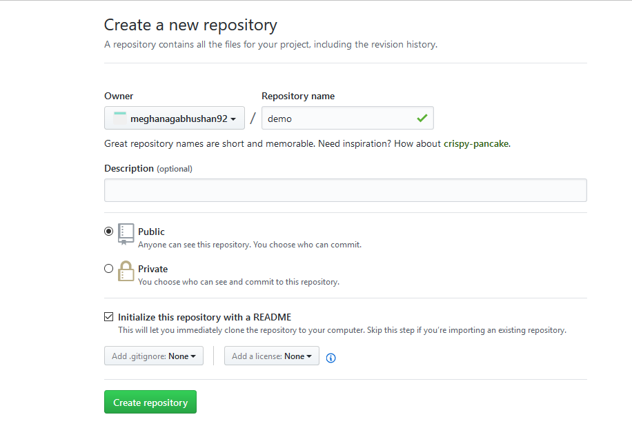
2. Create Repository
Create a sample repository

Slide 8
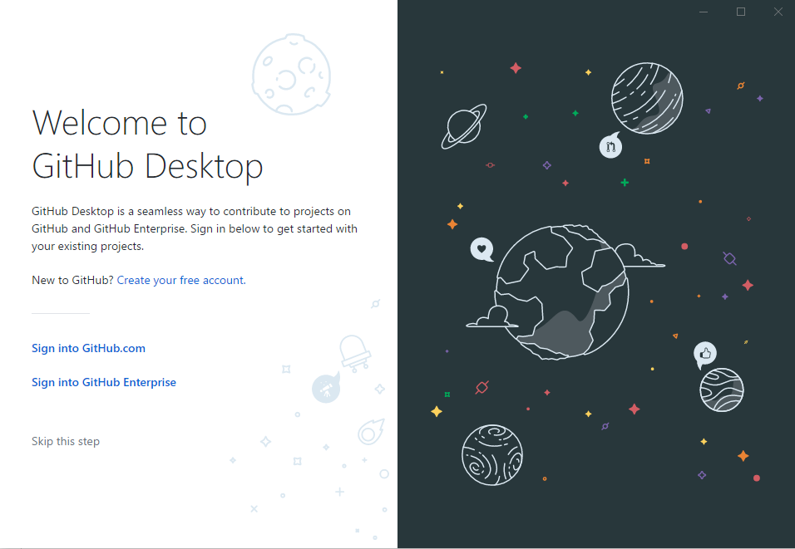
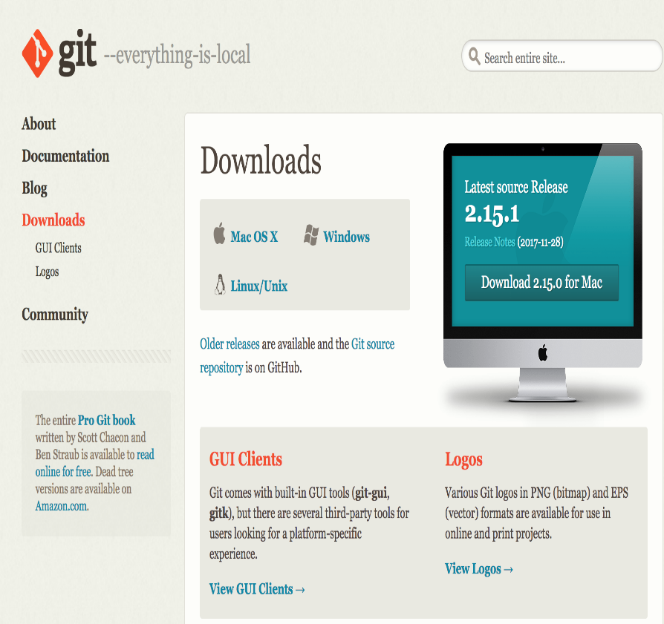
Git Shell/Desktop
Download Git shell using this link - https://git-scm.com/downloads
Download GitHub Desktop using this link -https://desktop.github.com/

Slide 9
Using Git Desktop

Slide 10

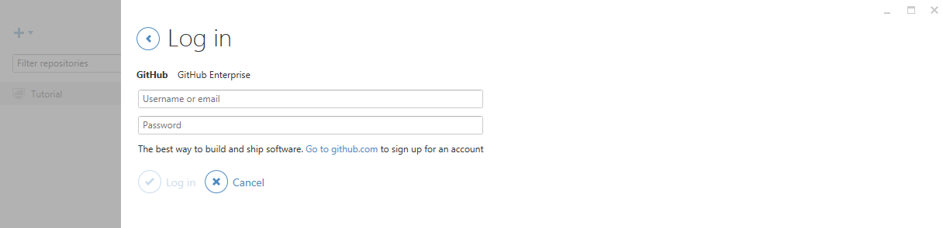
Git Desktop
Open GitHub desktop
Login to GitHub desktop with your GitHub account (It is very important to login before you do the rest of steps. Because after you login, you secure connection has been made)

Slide 11
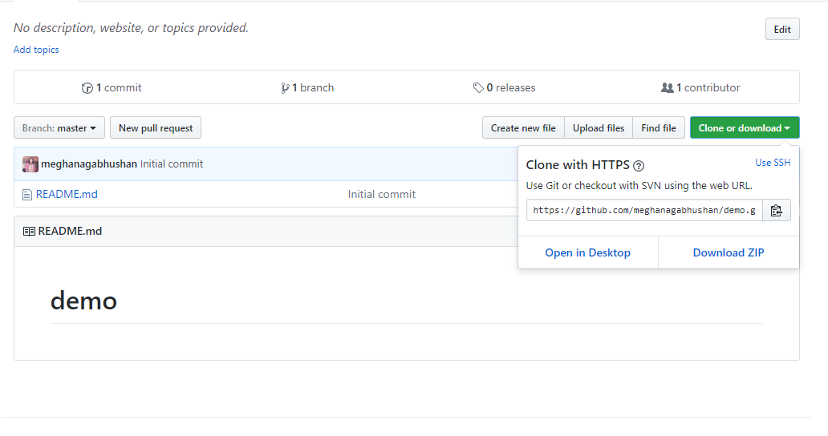
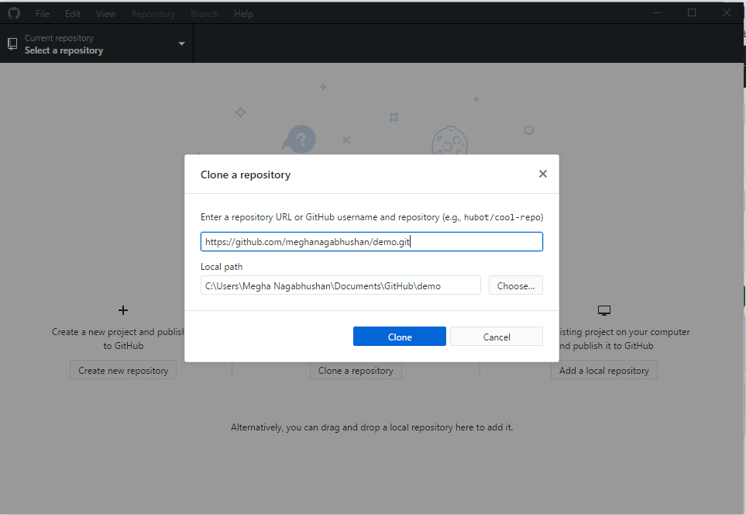
3. Clone repository to your local
Click on "Clone or Download" -> "Open in Desktop”
Choose the path to save your repository

Slide 12
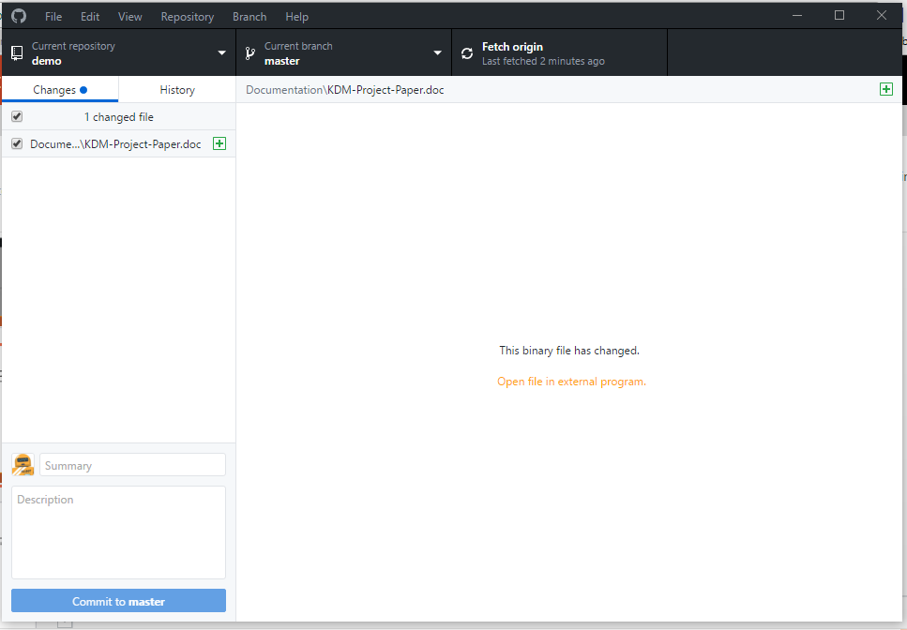
4. Add file to local Repository
Go to the location of your repository
Create a Source and Documentation folder
Add a sample file in the Documentation folder

Slide 13
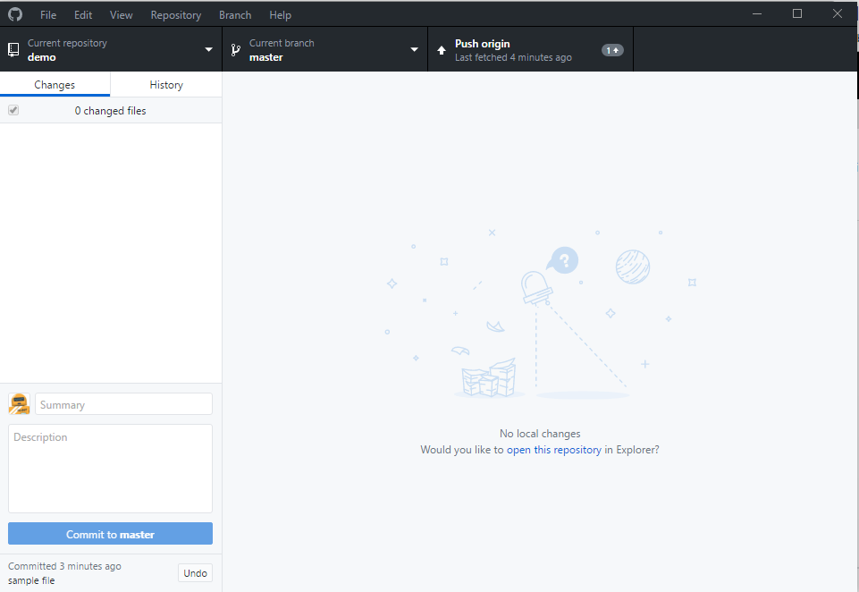
5. Commit this change
Fill summary and description boxes and click on Commit to master
Click on "Push origin" at the top of the git desktop screen.

Slide 14
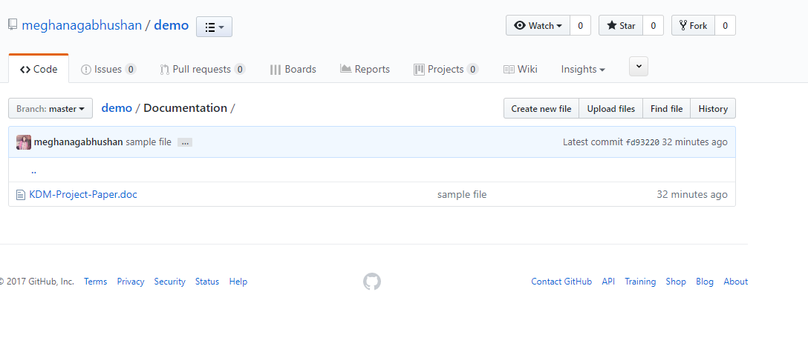
6. Push the change to remote
Open the repository on your GitHub
The file will now be visible in your repository

Slide 15
Using Git bash(Shell)
Notes:
https://gist.github.com/hofmannsven/6814451

Slide 16
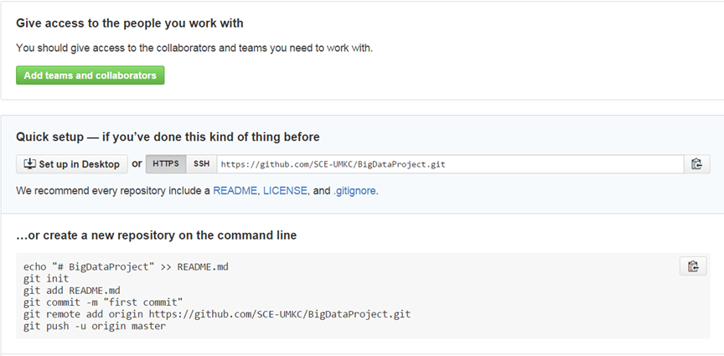
3. Clone repository to your local
Copy the repository link git clone https://github.com/xxxxxxx.git

Slide 17
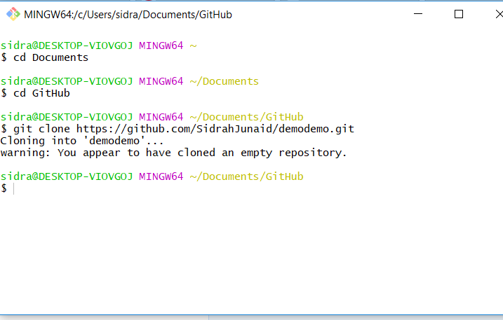
3. Clone repository to your local
Open git bash and clone repository in your desired folder

Slide 18
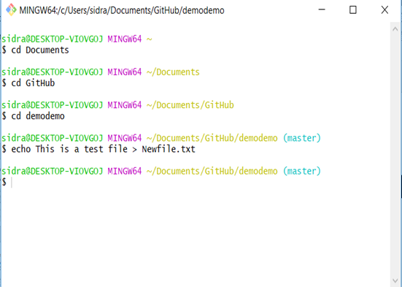
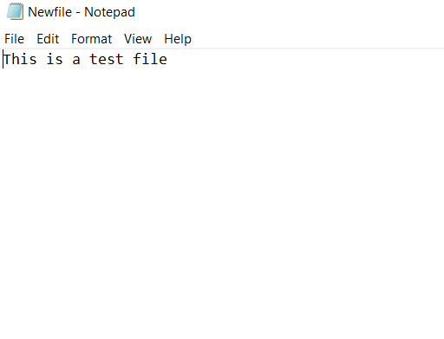
4. Add file to local repository
For creating a text file window users

Slide 19
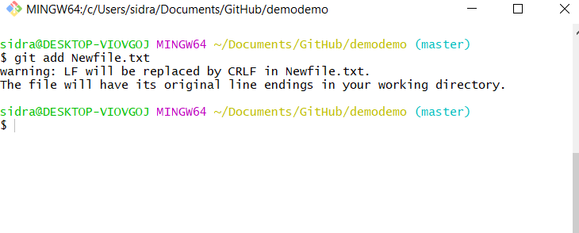
4. Add a file from local

Slide 20
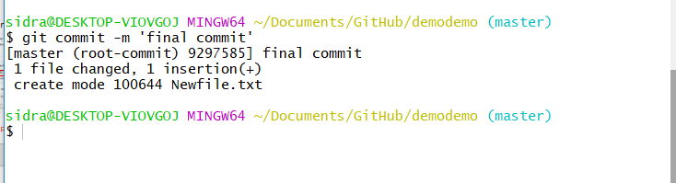
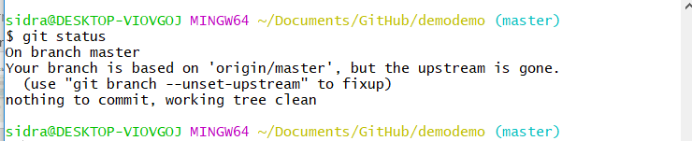
5. Commit this change
After commit, you can check git status to see if work directory clean

Slide 21
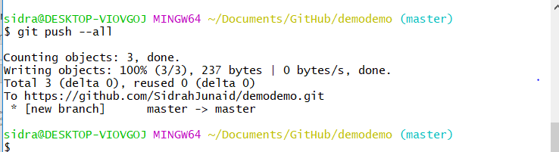
6. Push the change to remote
Push all changes to remote GitHub

Slide 22
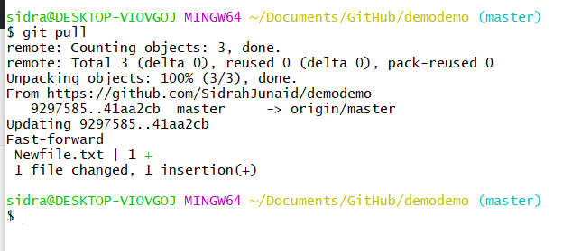
7. Sync local with remote
If something change in remote, for sync purpose, you can type

Slide 23
Git Project Management

Slide 24
1. Branch
Create a branch
Delete a branch
Force delete a branch
Rename current branch

Slide 25
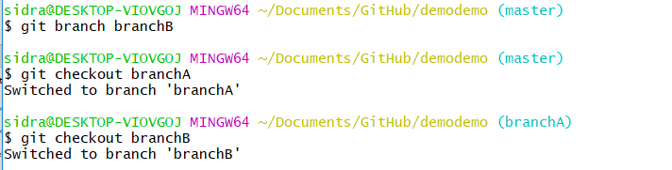
2. Checkout
A and B has to checkout their own branch to work on

Slide 26
3. Merge
•User A works on featureA, after finish, user A commit it with the message ‘finish featureA’
•git commit –m ‘finish featureA’
•User B works on featureB, after finish, user B commit it with the message ‘finish featureB’
•git commit –m ‘finish featureB’
•User C works on main features on master branch, user C commit it with the message ‘finish main features’
•git commit –m ‘finish main features’

Slide 27
For now, Windows users have done all basic steps.
But for Linux and Mac users, there are some more steps

Slide 28
To configure Git to Windows cmd
http://www.chambaud.com/2013/07/08/adding-git-to-path-when-using-github-for-windows/

Slide 29
(Configuring Terminal for Non-Windows User)
• For Linux or Mac user, we have more work to do before pushing changes to remote
Here are the steps
1. Generating new SSH Key and adding SSH Key to the ssh-agent
2. Adding a new SSH key to your GitHub account
Notes:
http://sourabhbajaj.com/mac-setup/Git/README.html

Slide 30
1. Generating new SSH Key and adding SSH Key to the ssh-agent
•1. Generate a SSH key with your GitHub email address
ssh-keygen -t rsa -b 4096 -C “your_email@example.com”
•2. It will ask you the file name
Enter a file in which to save the key (/Users/you/.ssh/id_rsa): [Press enter]
•3. Save this key and passphrase. Give the key name and make passphrase as empty.
Enter passphrase (empty for no passphrase): [Type a passphrase]
Enter same passphrase again: [Type passphrase again]
•For example:
we give key name as id_rsa, key pair would be: id_rsa and id_rsa.pub

Slide 31
Contd…
4. Adding SSH key to the ssh-agent
eval "$(ssh-agent -s)”
5. If you're using macOS Sierra 10.12.2 or later, you will need to modify your ~/.ssh/config file to automatically load keys into the ssh-agent and store passphrases in your keychain.
Host * s
AddKeysToAgent yes
UseKeychain yes
IdentityFile ~/.ssh/id_rsa
6. Adding ssh key to ssh-agent
ssh-add -K ~/.ssh/id_rsa

Slide 32
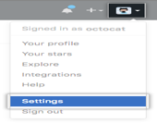
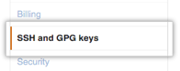
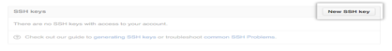
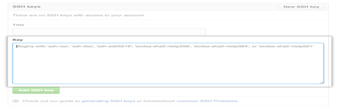
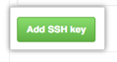
2. Adding SSH key to GitHub account
1. Copy key to your GitHub account
In the user bar in the top-right corner of page,
click setting button
2. Click SSH Keys in the left sidebar
3. Click Add SSH key
4.In the Title field, add a descriptive label for key
Paste your key into the "Key" field
5. Click Add key.

Slide 33
Testing
6. SSH to GitHub for testing ssh -T git@github.com
7. Switching remote URLs from HTTPs to SSH
git remote set-url origin git@gxxxxxx.gits

Slide 34
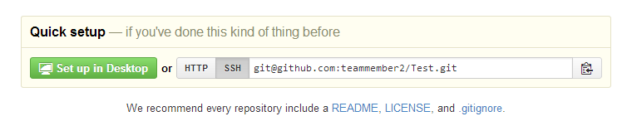
Contd…
8. Now you can push using
git push –all
9. If something change in remote, for sync purpose, you can type
git pull

Slide 35
Zen Hub

Slide 36

Zen Hub
Zen Hub is a GitHub plugin for agile project management
It needs either Chrome or Firefox as the browser.
Go to https://www.zenhub.io/
Click “Add Zen Hub to GitHub”, it will install a plugin on your browser
Click plugin icon
It will ask you to login to GitHub (You have to create your GitHub account before)
After login, you have to grant the permission for Zen Hub to access your GitHub project
Done

Slide 37
Zen Hub for GitHub project management
Click issues, we can add issues
Click Boards, we can drag and drop stories to different completion status
Click burndown, we can add milestone and assign different stories to milestone and then generate burndown chart

Slide 38
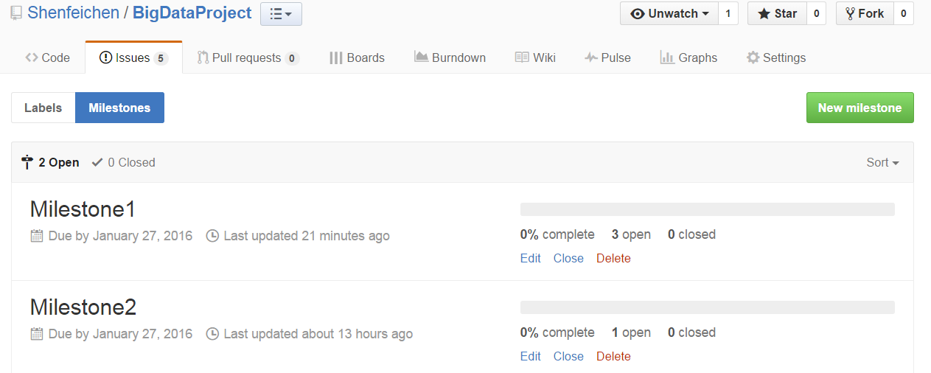
Adding Milestones
Issues → Milestones → New Milestones
You can create Milestones

Slide 39
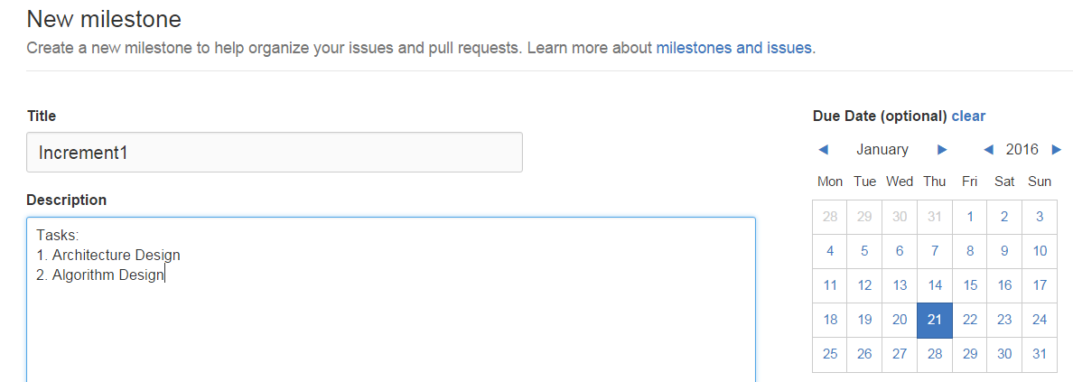
Add Milestone

Slide 40
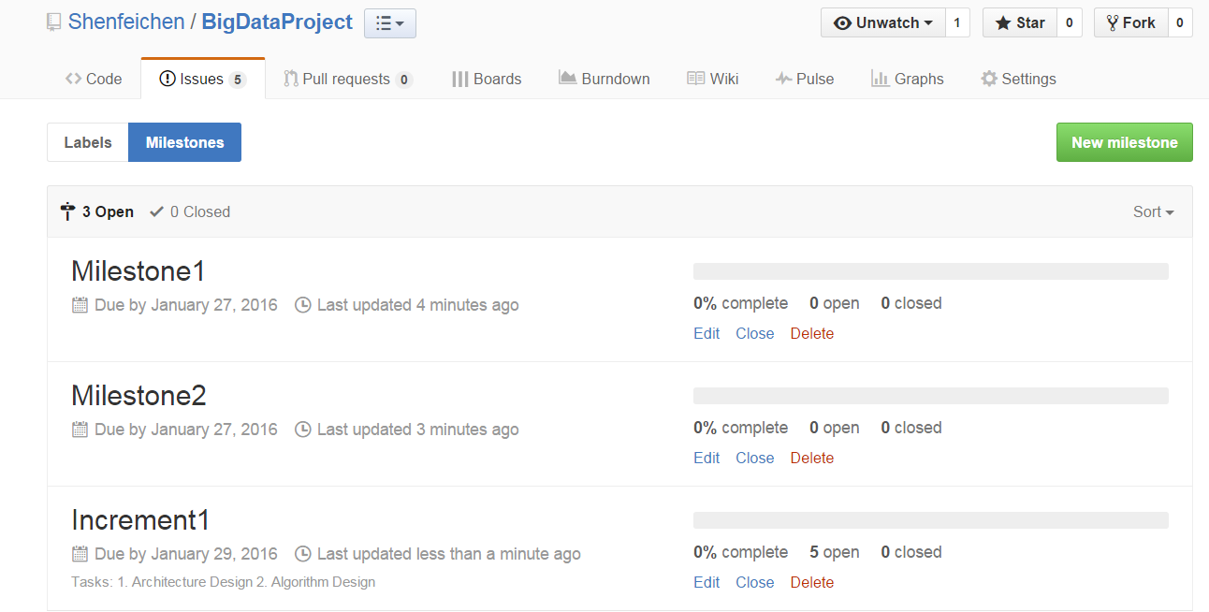

Slide 41
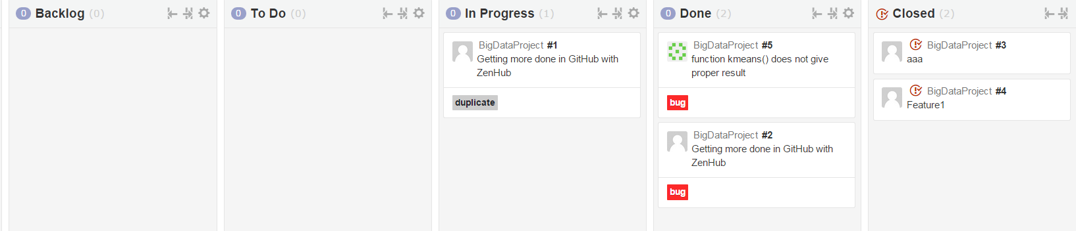
Updating Milestones
Increment1 has 5 issues
I drag two of them to “Closed” status

Slide 42
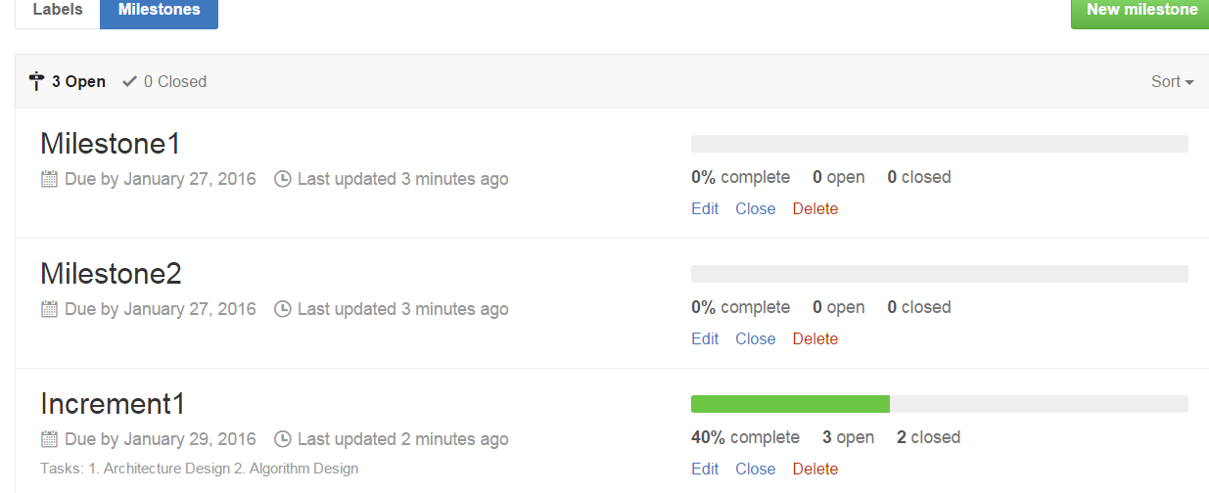
Milestones
Then the complete of Milestones will also change

Slide 43
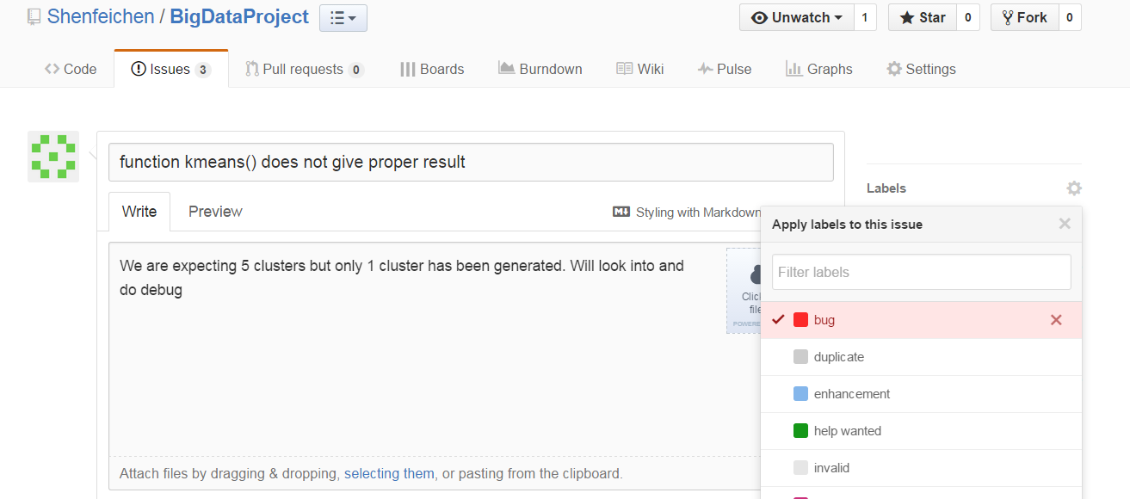
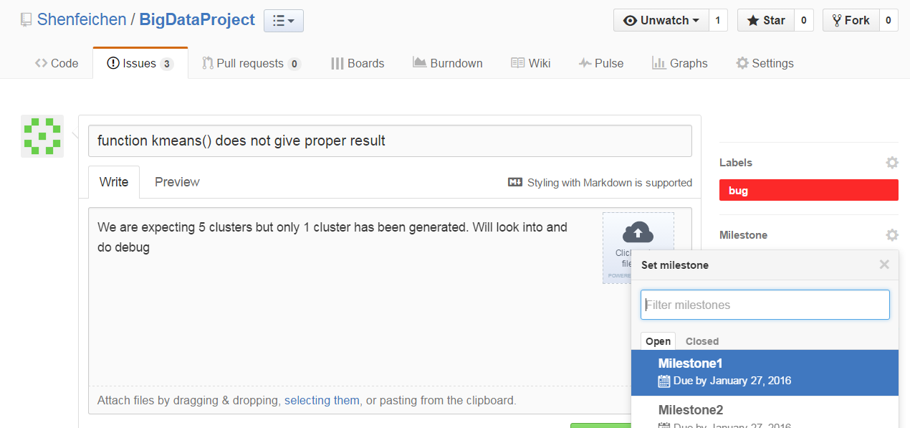
Adding Issues
Click issues
Click New issues (add filter, assignee, milestone, Story point etc. )

Slide 44
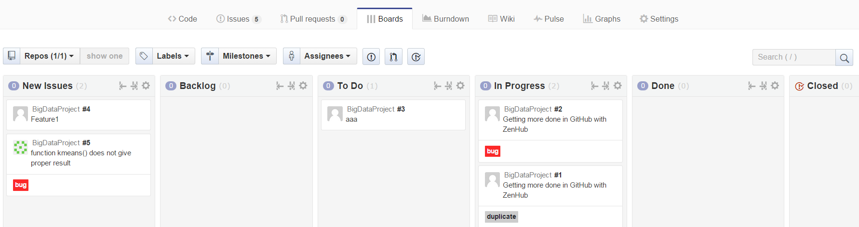
Boards

Slide 45
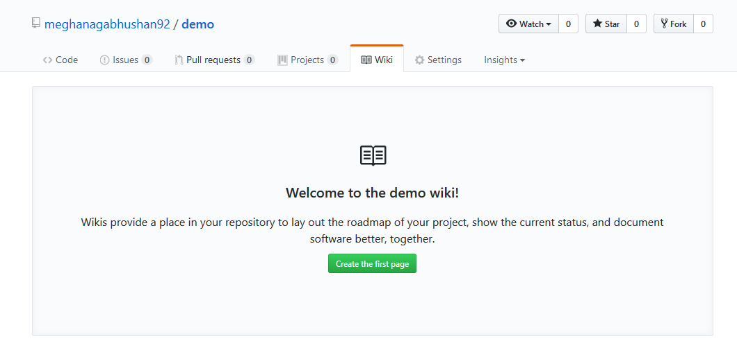
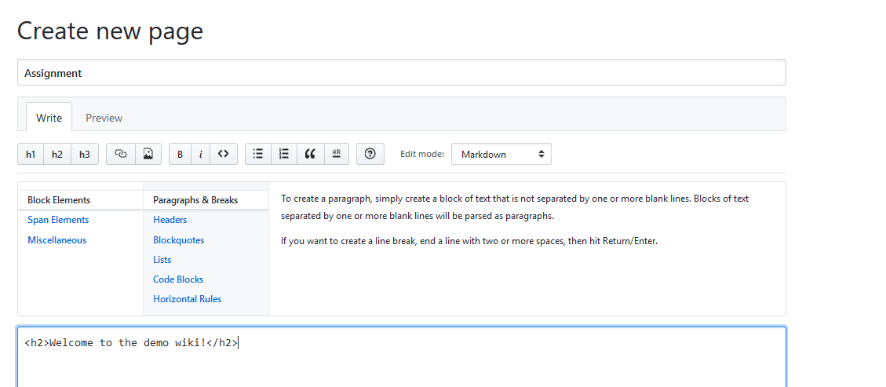
Wiki
Every GitHub repository comes equipped with a section for hosting documentation, called a wiki.
Notes:
https://github.com/ROHITHKUMARN/CS5551-ASE-Part1/wiki/Chat-application(Lab-Assignment-I)

Slide 46
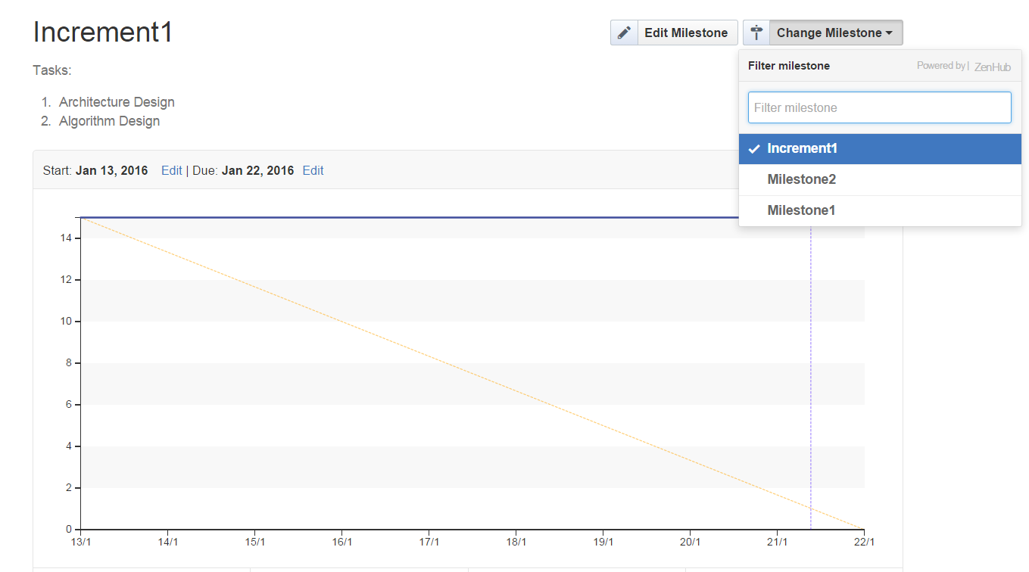
Build Burndown Chart
A burn down chart is a graphical representation of work left to do versus time.
Go to burndown option, select a specific milestone, to see the burndown chart

Slide 47
Creately

Slide 48
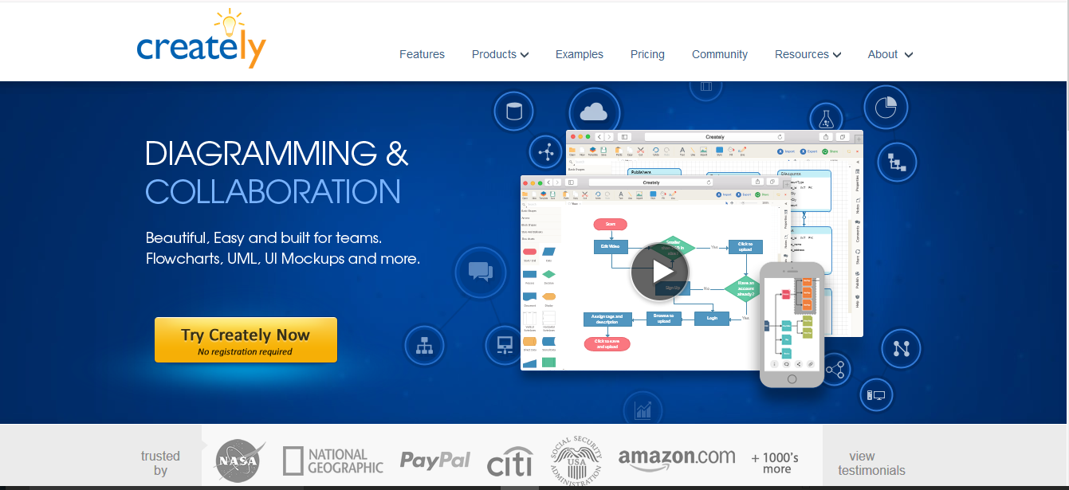
Creately
Creately is an online collaborative diagramming software
Draw flowcharts, mind maps, business process models, network diagrams and more
Go to https://creately.com/ and sign up

Slide 49
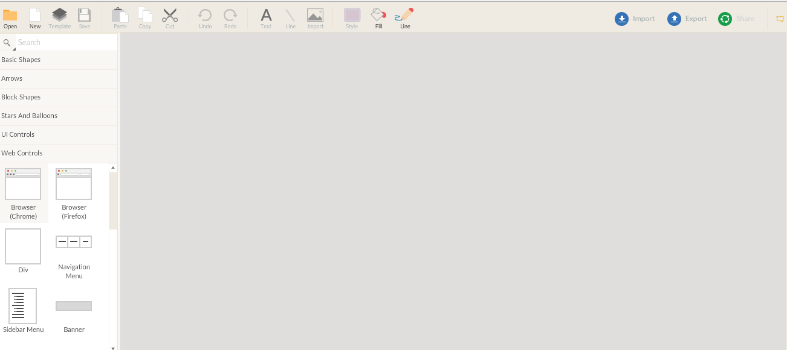
Using Creately
Click on Get more objects-> UML
Click New -> Blank diagram or use an existing template by typing in "sequence diagram" or "class diagram" etc.
Drag and drop the diagrams on the page

Slide 50
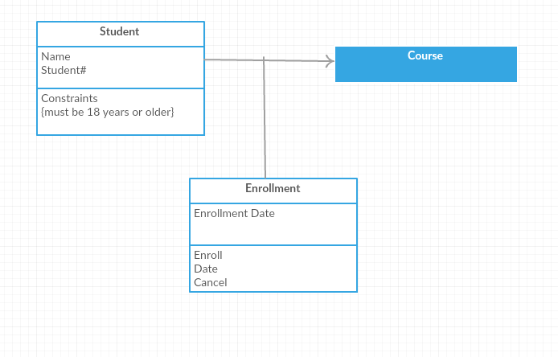
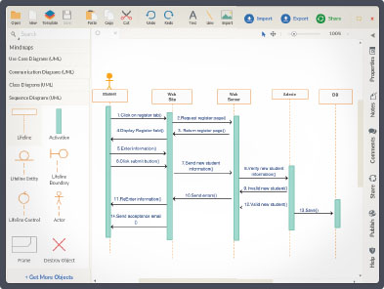
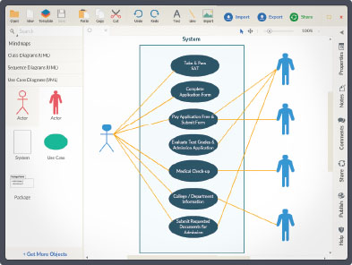
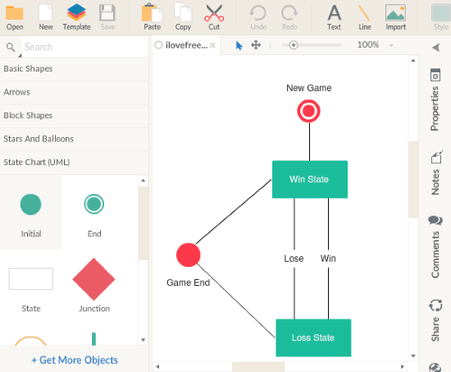
UML Diagrams
Class Diagram
Sequence Diagram
Use-case Diagram
Collabration Diagram

Slide 51
WebStorm

Slide 52
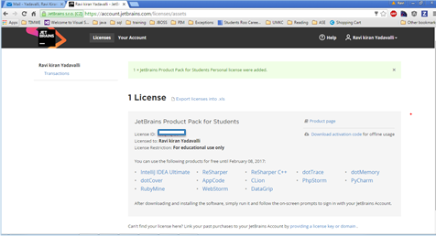
Web Storm
Is a IDE from Jet Brains for Web Projects
https://www.jetbrains.com/webstorm/download/#section=windows

Slide 53
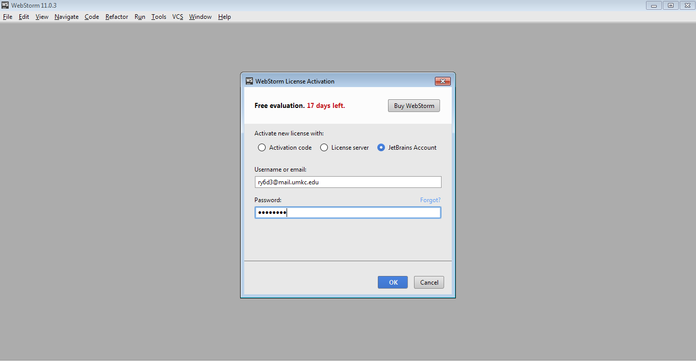
Web Storm Installation
If it is a New installation: Enter License key during installation
Otherwise : Go to Help > Register

Slide 54
Android Studio Installation

Slide 55
JDK Installation
Install Java Development Kit (JDK) to write Java (and Android)programs
Can download the JDK for your OS at http://www.oracle.com/technetwork/java/javase/downloads/jdk8-downloads-2133151.html
Run setup
Set Environment variable for java
Check that java is installed correctly on your machine by typing javac on terminal

Slide 56
Installing JDK for Non –Windows users
Alternatively, for OS X, Linux:
OS X:
Open /Applications/Utilities/Terminal
Type javac at command line, install Java at prompt
Linux(Debian/Ubuntu):
sudo apt-­‐get install java-­‐package,
download the JDK <jdk>.tar.gz file from Oracle
run make-­‐jpkg<jdk>.tar.gz, then
sudo dpkg –i <resulting-­‐deb-­‐file>

Slide 57
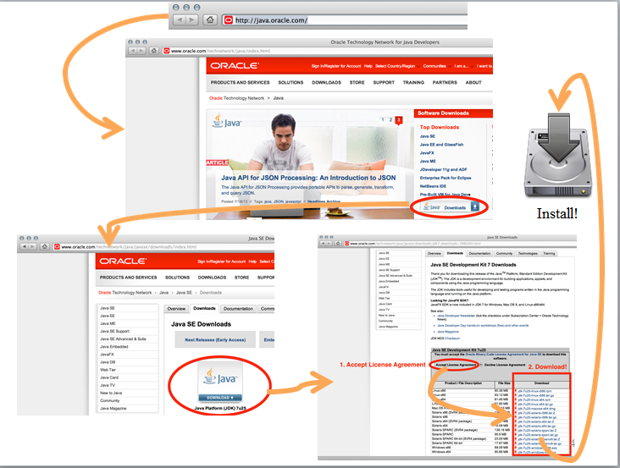
.

Slide 58
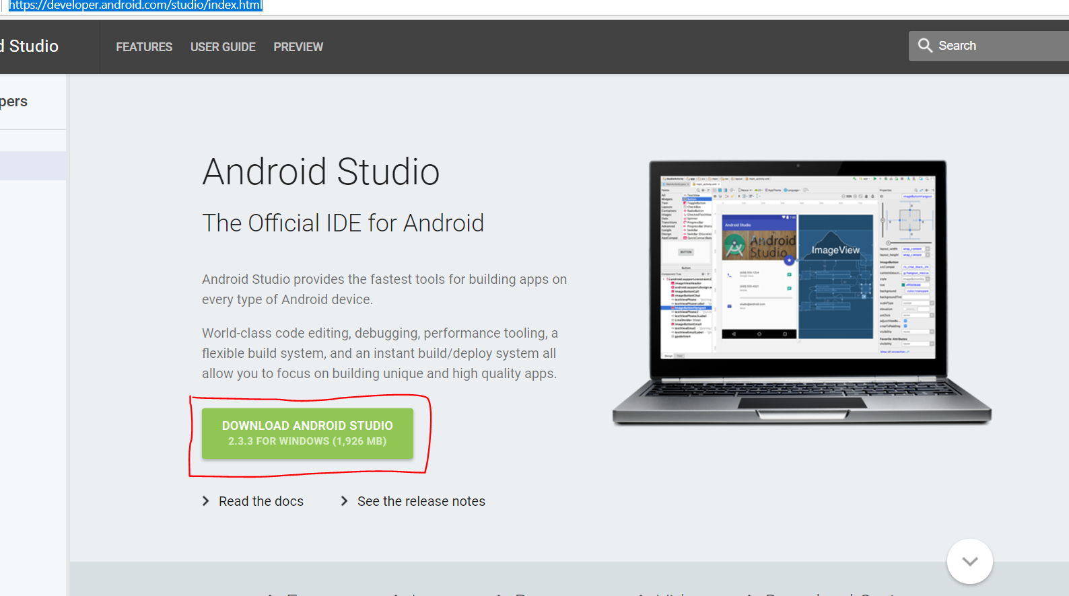
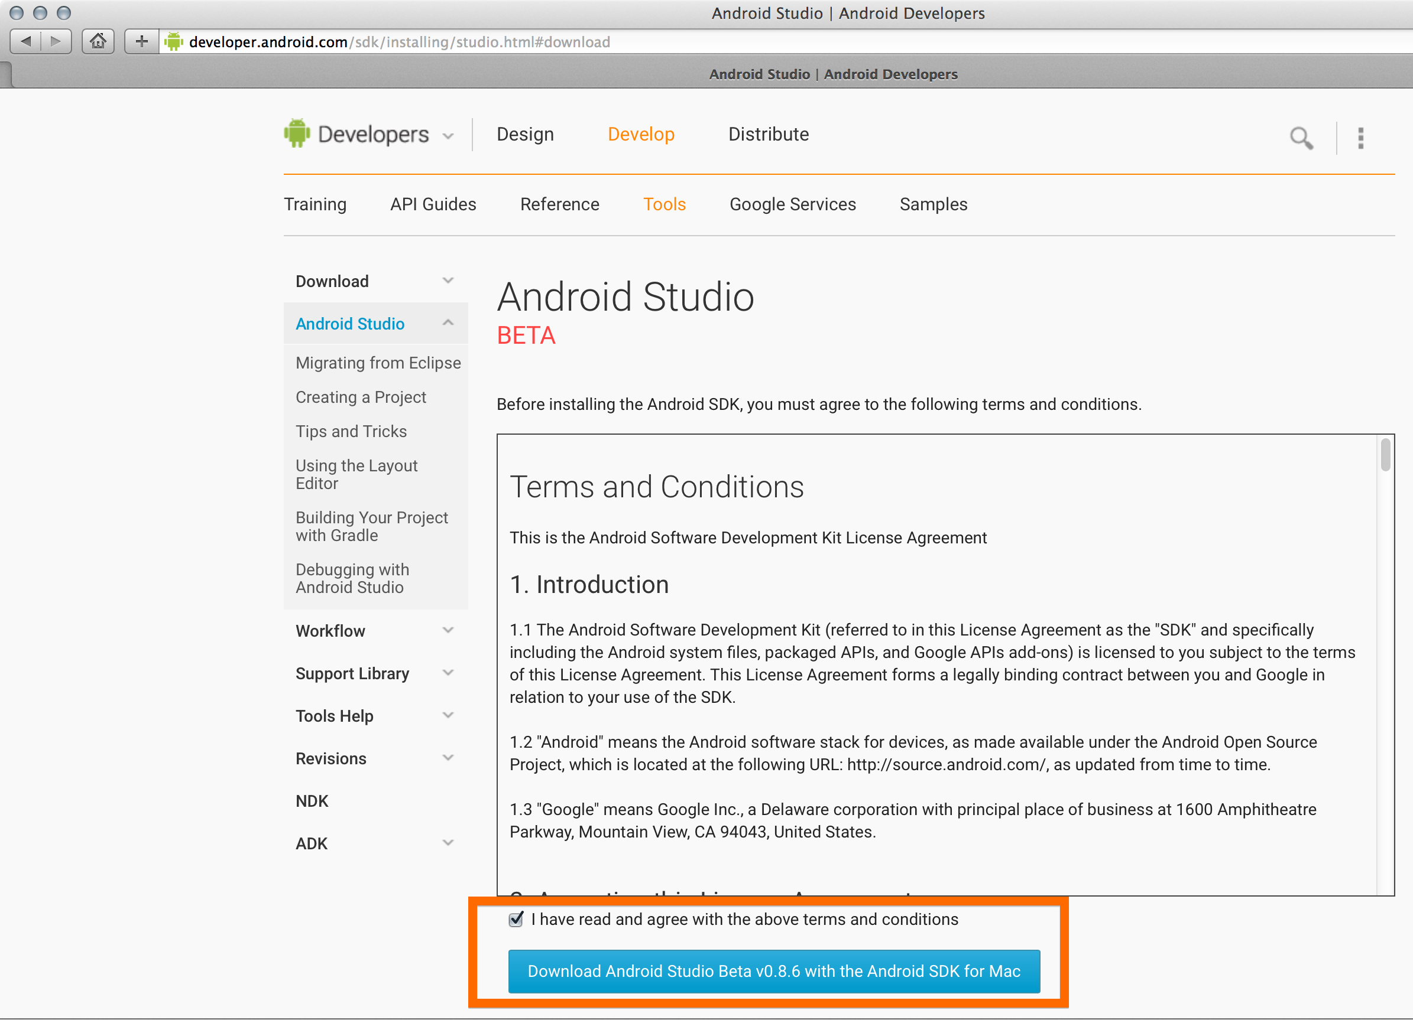
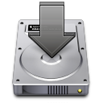
Getting Started
Download and install Android Studio bundle (including Android SDK) for your OS
http://developer.android.com/sdk/index.html
Install!

Slide 59

Brackets IDE

Slide 60


Brackets
Go to:
http://brackets.io/
Install the following extensions in adobe brackets for a better developer experience:
AngularJS Code Hints
Angular JS for Brackets
ionic-brackets
ionic Framework Code Hinting
Simple JS Code Hints

Slide 61
Ionic, Node, NPM Installations

Slide 62
Setup
Step 1: Install Android SDK
Step 2: Install Brackets http://brackets.io/
Step 3: Install Angular JS & Ionic extensions in Adobe brackets
Step 4: Install node js
https://nodejs.org/en/
Step 5: Install ionic command line tools
More Info : http://ionicframework.com/docs/guide/installation.html

Slide 63


node js installation
Download the system specific build.
https://nodejs.org/en/

Slide 64

Node js Verification
Open terminal/command prompt and type “npm” or “npm -v” to check the installation.

Slide 65
npm(node package manager)
Default package manager for the JavaScript runtime environment Node.js.
Installed automatically with the environment.
npm is written entirely in JavaScript
It installs the packages you want to use and provides a useful interface to work with them.
Online repository for publishing open-source Node.js projects.
Command line utility to install Node.js packages
https://docs.npmjs.com/getting-started/what-is-npm

Slide 66

Install Ionic
Command
npm install -g cordova ionic
All unix based OS users, don’t forget to use the mighty “sudo”

Slide 67

Ionic verification
There are different options for the command “ionic”
There are different types of app templates available . (next slide)

Slide 68
END

Slide 69
THANK YOU

